Slide 1
Part 6 Final Submission CRYPTOGEAR
TEAM MEMBERS
JOSE CANIZARES
RAYMOND DUNCAN
SAYED SARDER
ANH-KHOA THAN

Slide 2
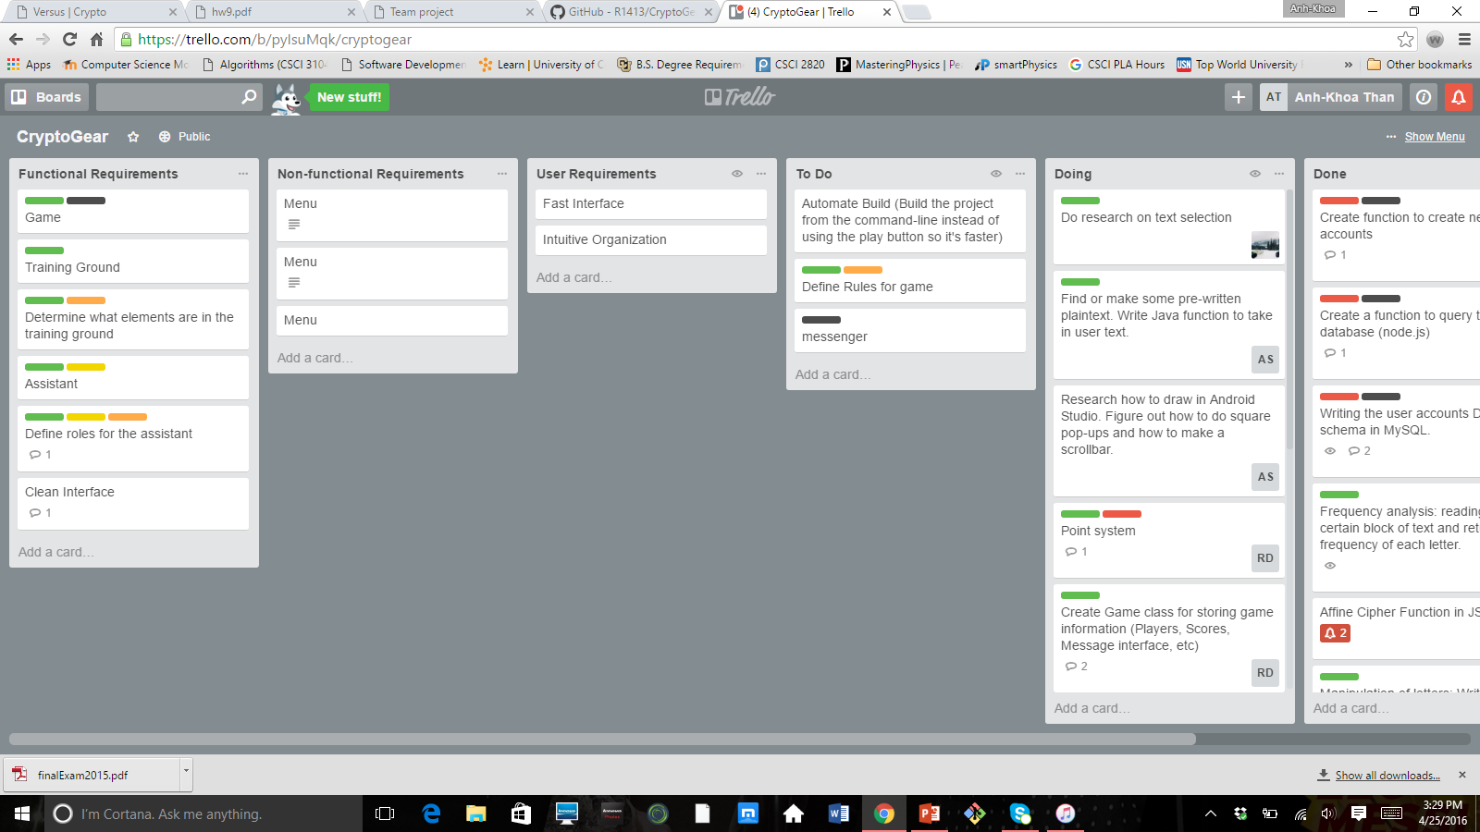
TRELLO
LINK: https://trello.com/b/pyIsuMqk/cryptogear

Slide 3
LINK TO OUR GITHUB REPOSITORY
https://github.com/R1413/CryptoGear
LINK TO OUR README: https://github.com/R1413/CryptoGear/blob/master/Android/README.md

Slide 4
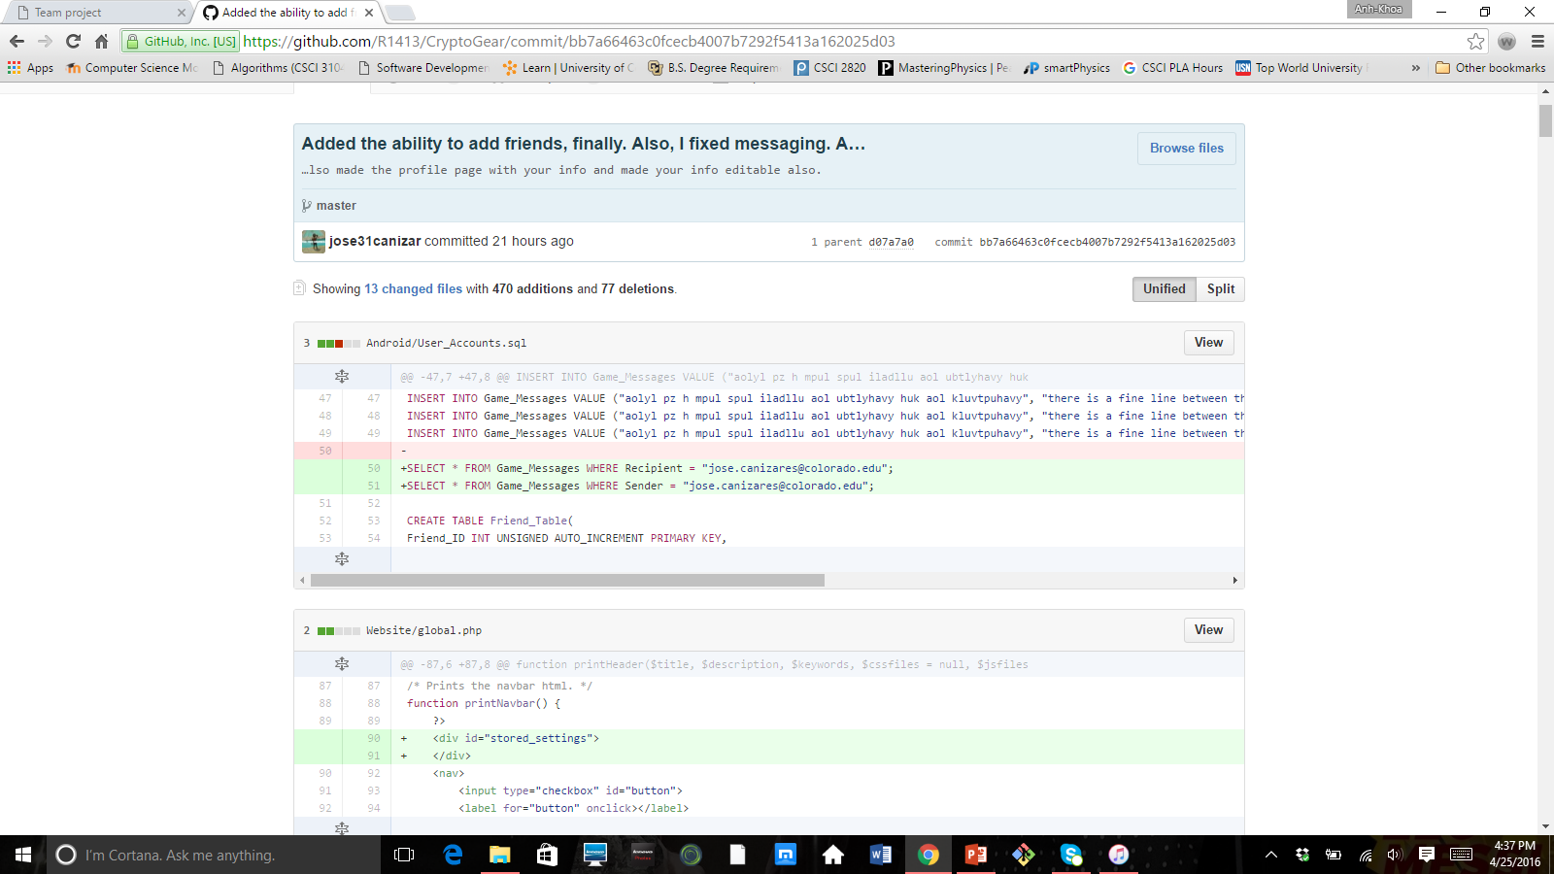
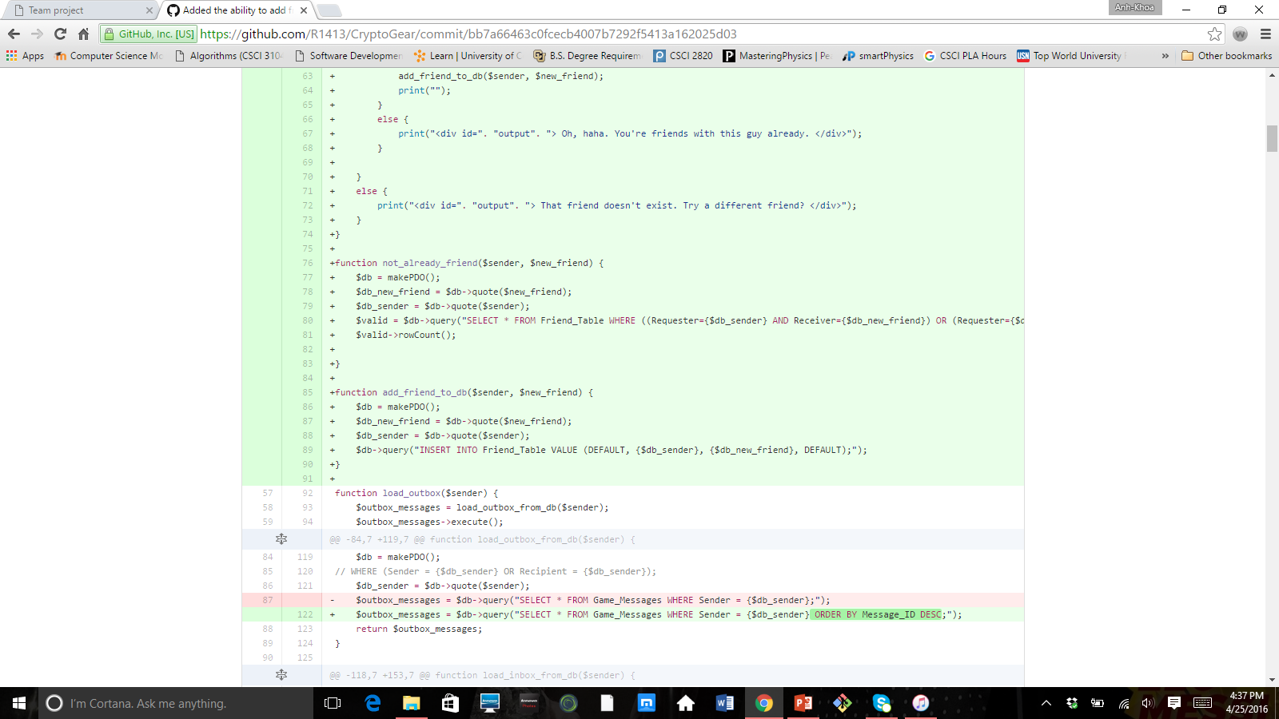
SCREENSHOTS OF JOSE CANIZARES’CONTRIBUTION

Slide 5
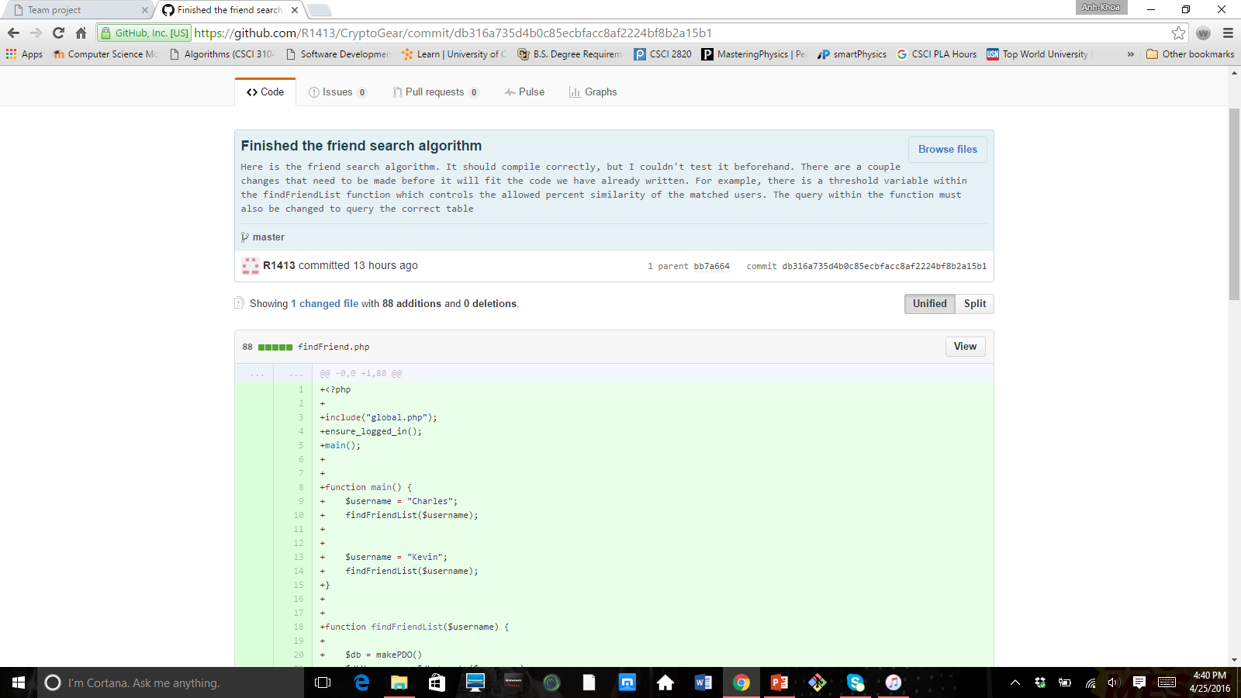
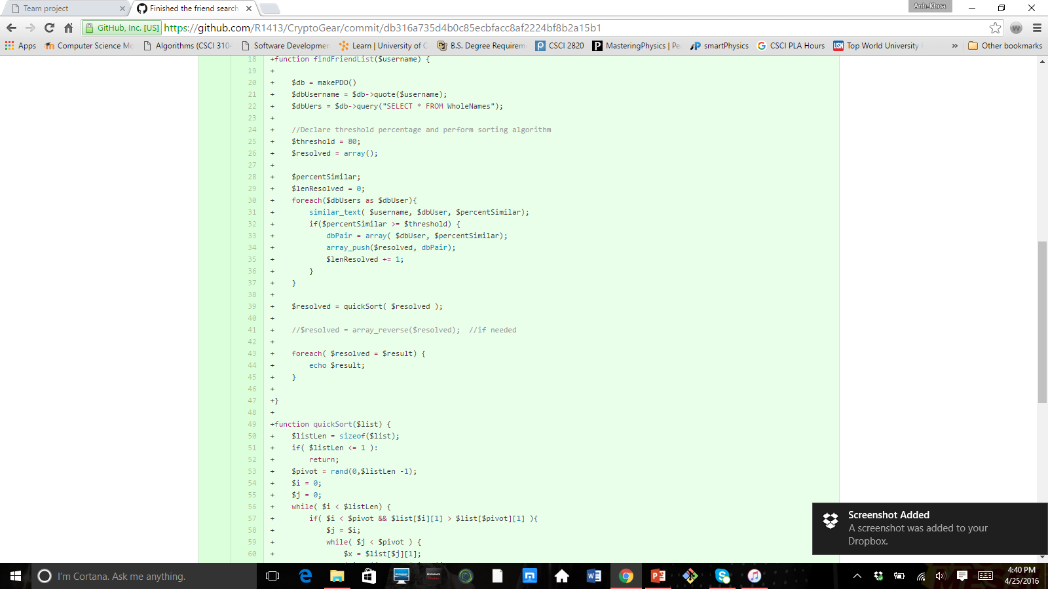
SCREENSHOTS OF RAYMOND DUNCAN’S CONTRIBUTION

Slide 6
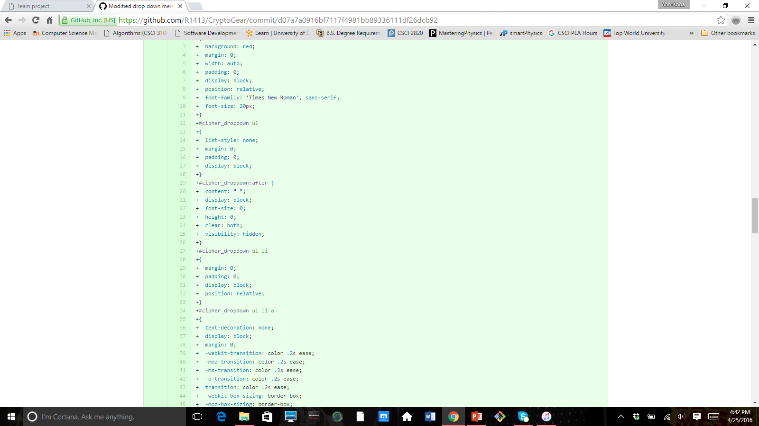
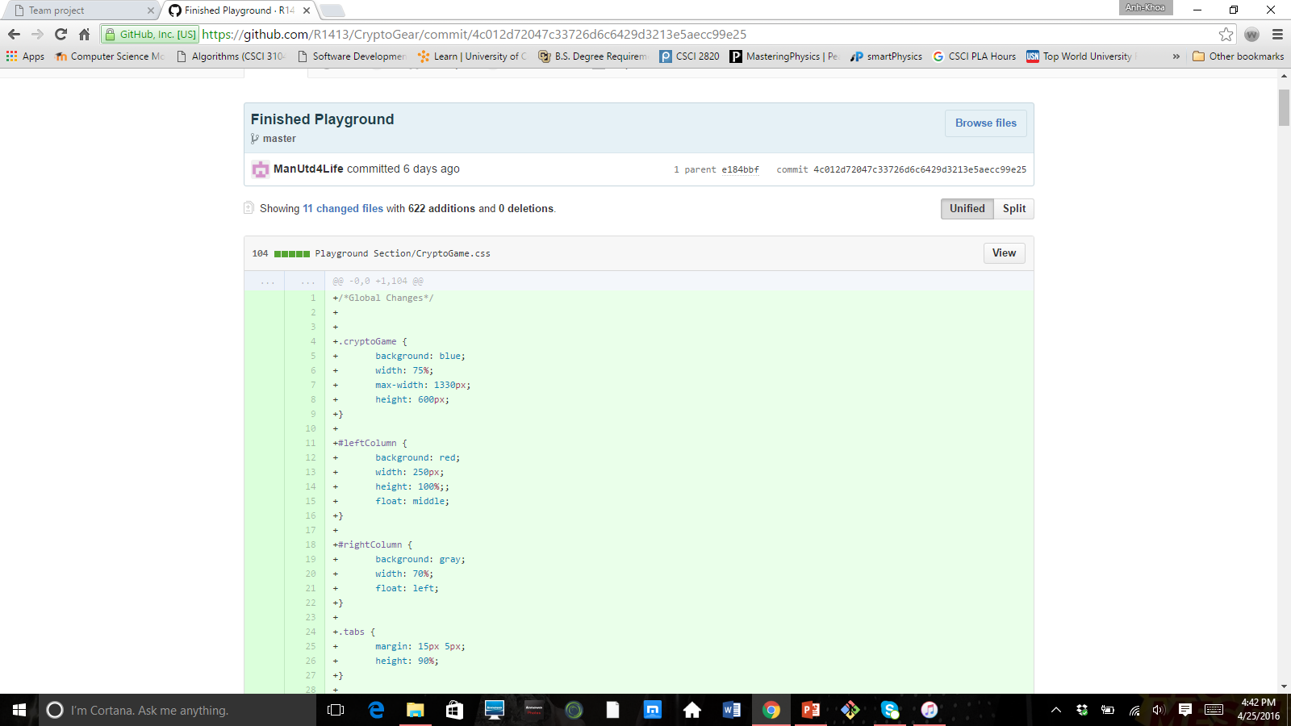
SCREENSHOTS OF ANH-KHOA THAN’S CONTRIBUTION

Slide 7
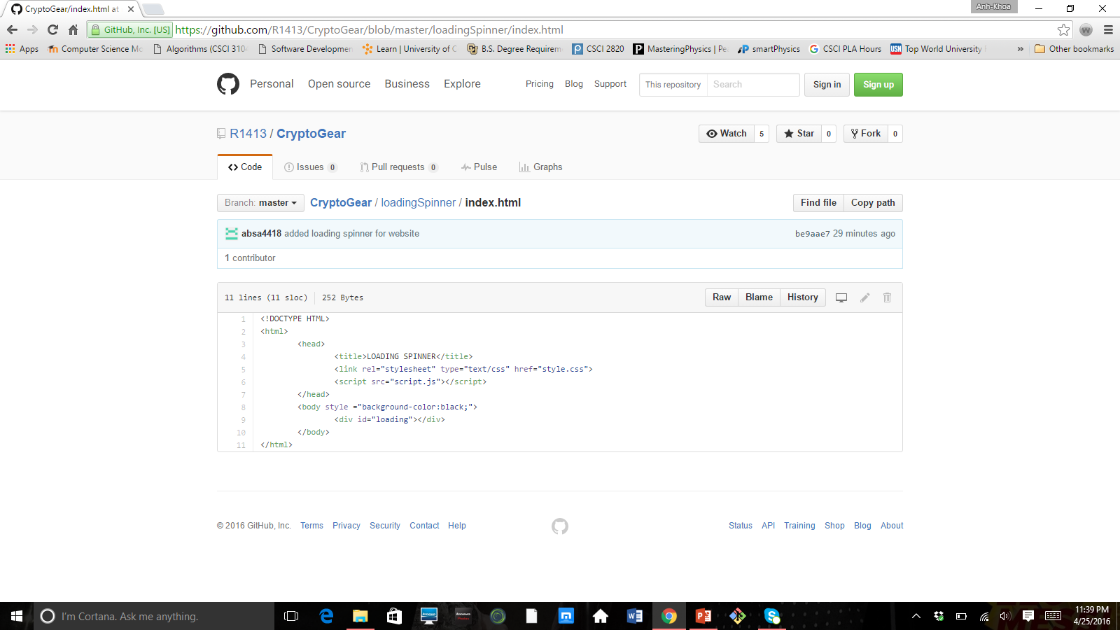
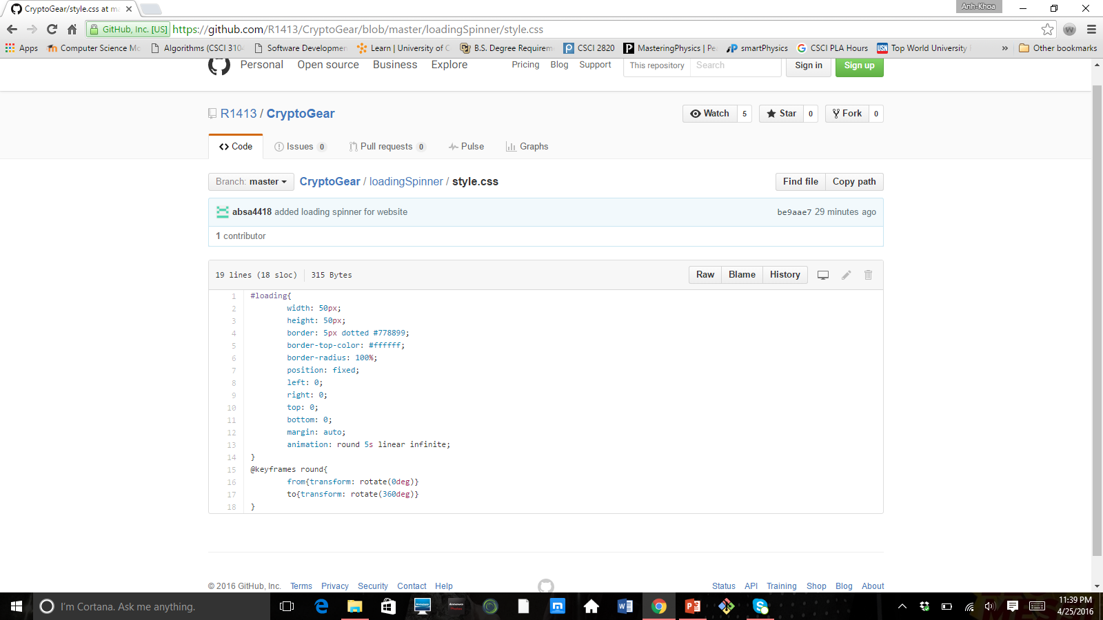
SCREENSHOTS OF SAYED SARDER’S CONTRIBUTION

Slide 8
DEPLOYMENT ENVIRONMENT
WE USED JUMPLINE WEB HOSTING TO HOST OUR WEBSITE
http://jumpline.com/

Slide 9
LINK TO OUR FINAL WEBSITE
http://crypto.vivoapplications.com/

